Slide 1
C-STORE OFFICE
ADVANCED ACCOUNTING – Accounts Receivable

Slide 2
Agenda
What does accounts receivable mean?
Where can I find accounts receivable in CStore?
How do I collect on these invoices?
Why is accounts receivable important?

Slide 3
WHAT DOES ACCOUNTS RECEIVABLE MEAN?
Accounts receivable refers to the outstanding invoices a company has or the money the company is owed from its clients. The phrase refers to accounts a business has a right to receive because it has delivered a product or service.
Receivables essentially represent a line of credit extended by a company and due within a relatively short time period, ranging from a few days to a year.
Hint Accounts RECEIVE-able – You are receiving $ for goods and services completed

Slide 4
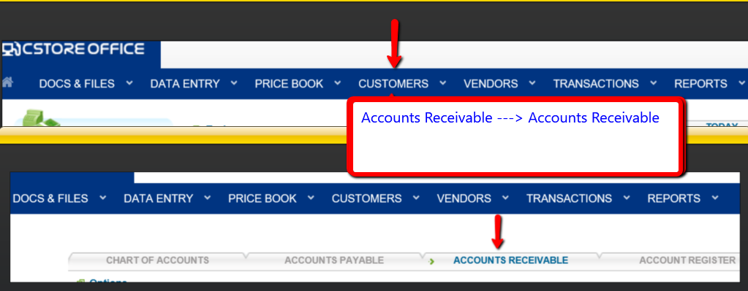
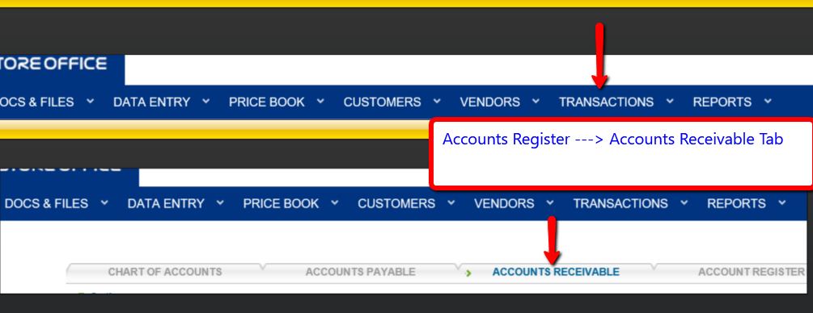
WHERE CAN I FIND ACCOUNTS RECEIVABLE IN CSTORE?
Option 1: Customers > drop down icon > Accounts Receivable > Accounts Receivable tab
Option 2: Transactions > drop down icon > Account Register > Accounts Receivable tab
Option 1
Option 2

Slide 5
HOW DO I COLLECT ON THESE INVOICES?
Step 1: Input the highlight areas with the information you want to locate.
Step 2: Select the check-box for the invoice/s you want to collect.

Slide 6
HOW DO I COLLECT ON THESE INVOICES?
* You may collect partial amounts as well: Type the amount value in the Amt. to Rec field, and then click any place outside the field. The new amount appears at the bottom of the total column. * Check your work by finding $25.00 at the right bottom of the page instead of $50.00

Slide 7
HOW DO I COLLECT ON THESE INVOICES?
Step 3: Input Payment Attributes.

Slide 8
WHY IS ACCOUNTS RECEIVABLE IMPORTANT?
It is first and foremost important to be able to track money owed to you in an organized manner to reflect an aging accounts receivable report.
Viewing an accurate cash flow statement is based on accounts receivable collections.
Establish your good customers that pay on time and in full.

Slide 9
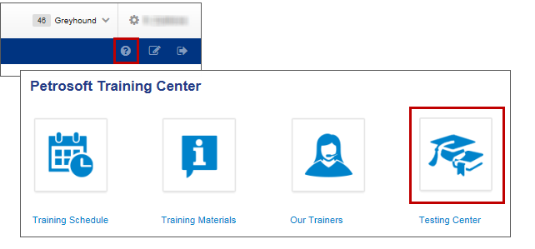
TRAINING CENTER
For additional testing on what you have learned, please refer to our new “Testing Center”.
To access this new feature, click the help icon, and then select Testing Center.
For additional information, please refer to the Accounts Receivable section at Petrosoft Cloud Help. Go to C-Store Office > Accounting > Accounting Module in C-Store Office > Accounts Receivable.

Slide 10
THANK YOU FOR YOUR TIME!
Get in Touch
www.cstoreoffice.com
Petrosoft LLC
290 Bilmar Drive
Pittsburgh, PA 15205
1.412.306.0640

